Slide 1
WEEK 4 K Nearest Neighbors

Slide 2
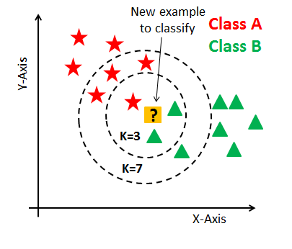
KNN Classifier

Slide 3
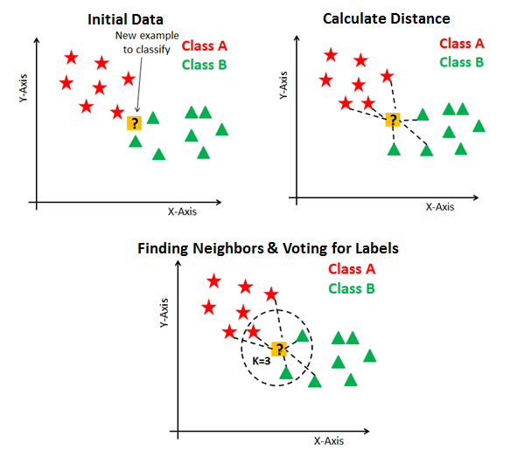
How KNN Classifier works ?

Slide 4
Lazy Learning
KNN does not learn by gradient descent,
it just memorizes training data.

Slide 5
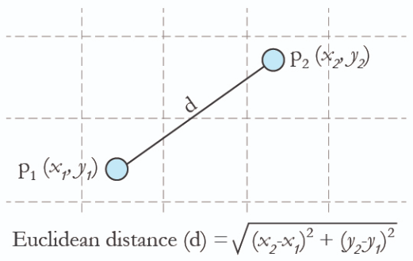
Euclidean Distance

Slide 6
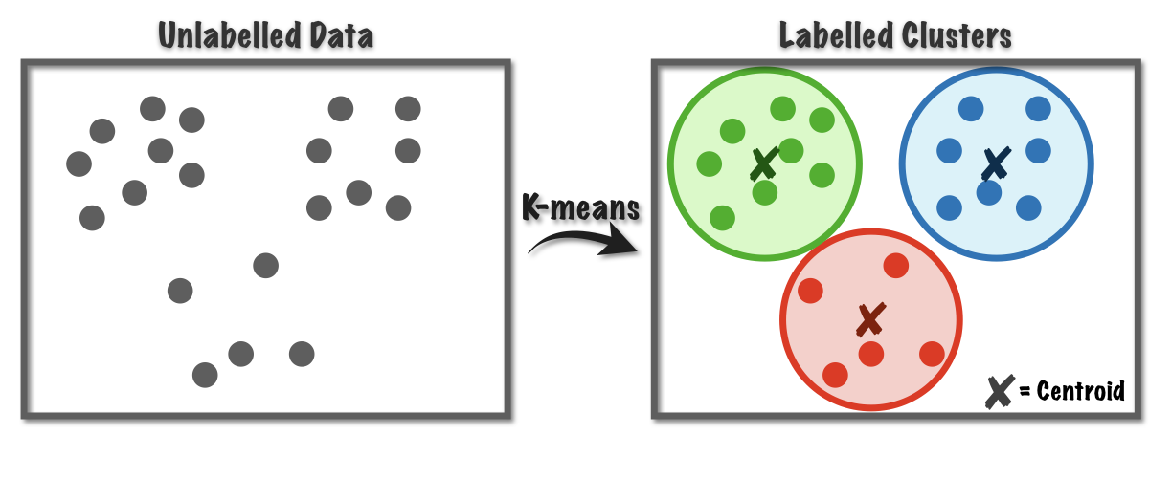
K Means Clustering

Slide 7
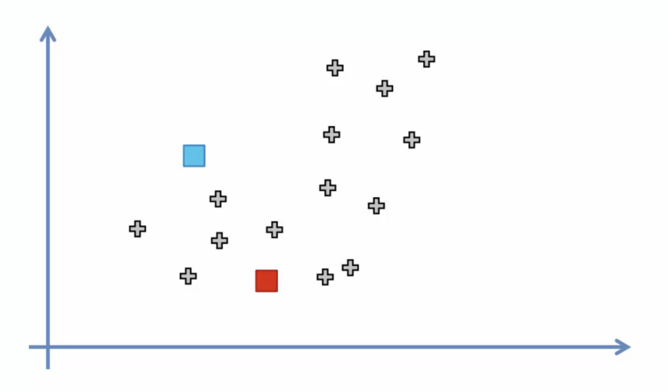
Steps of K Means Clustering
1) Select K random points as cluster centers called centroids.

Slide 8
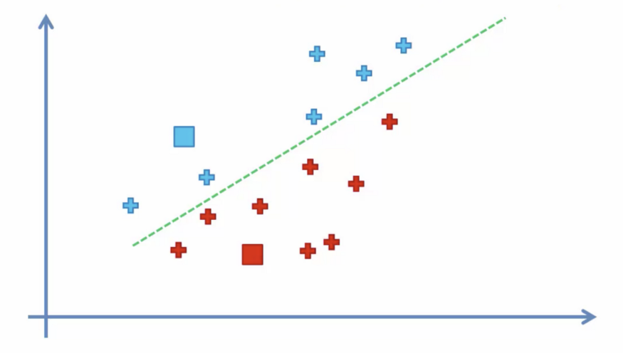
2) Assign each data point to the closest cluster with respect to each centroid.

Slide 9
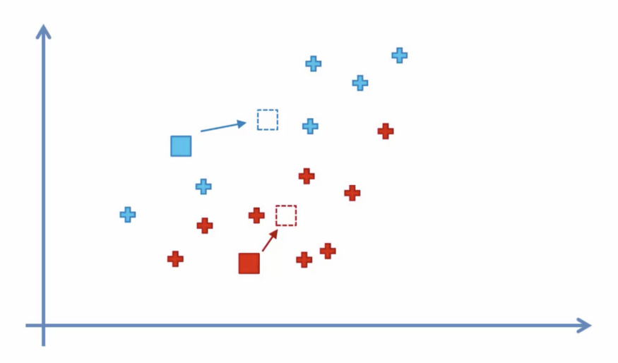
3) Determine new cluster centers by computing average of the assigned points.

Slide 10
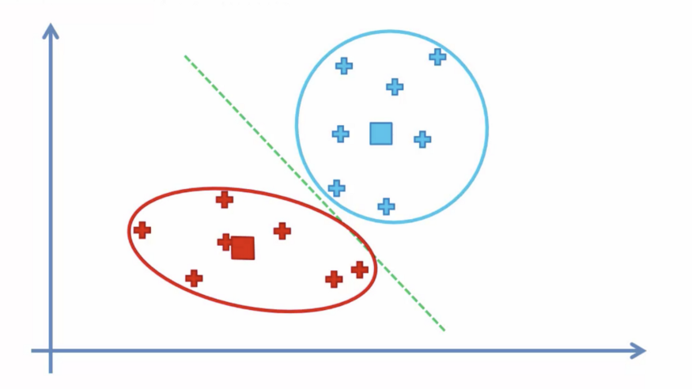
4) Repeat steps 2 and 3 until clusters do not change or max iteration number is exceeded.

